Slide 1
Music Genre Prediction

Slide 2
Table of Contents
Agenda
Understanding the features
Process followed in the project
Deductions from EDA process
Illustration of plots
Feature Engineering
Model Evaluation
Conclusion

Slide 3
Agenda
Music has been known to humans for times immemorial. Ever since the melody of instruments has fallen on the ears of humans, it has implanted the seeds of emotions that are otherwise hard to achieve. While music is altogether a melody that connects all hearts in this world, there are further classifications of music that bind together music lovers and keep the melody going on. Music Genre Classification or classification of music into different categories or genres is a concept that helps the masses to differentiate between 2 genres based on their composition or the beats they withhold. In recent times, music genre classification has become a very popular concept as more and more genres are emerging around the world.

Slide 4
Understanding the Features
instance_id
Artist_name
Track_name
Popularity
Acousticness
Danceability
duration_ms
Energy
Instrumentalness
Key
Liveness
Loudness
Mode
Speechiness
Tempo
Obtained_date
Valence
Music_genre

Slide 5
PROCESS
1
2
3
4
CORPUS COLLECTION
EDA
Feature
Engineering
Model Selection

Slide 6
Process followed in the project
Step 1: Problem Definition
Step 2: Data Collection
Step 3: Exploratory Data Analysis (EDA)
Step 4: Feature Engineering
Step 5: Train/Test Split
Step 6: Model Evaluation Metrics Definition
Step 7: Model Selection, Training, Predicition and Assessment
Step 8: Hyperparameter Tuning/Model Improvement

Slide 7
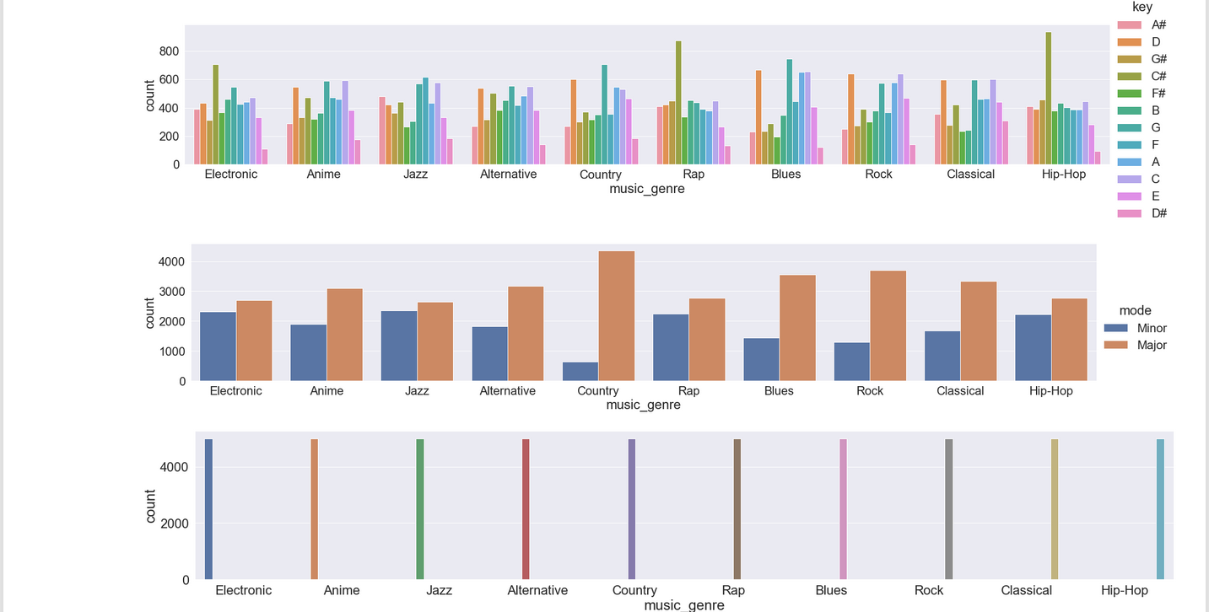
Illustration of plot

Slide 8
Naïve Bayes
Decision
Tree
KNN
Model
Evaluation
Random
Forest
Logistic
Regression
SVM

Slide 9
Model Evaluation
Several models are tested and measure their performance. These models will be optimized by tunning their hyperparameters.
Naïve Bayes
KNN
Logistic Regression
Decision Tree
Random Forest
Support Vector Machines

Slide 10
Conclusion
A basic machine learning pipeline based on a sample data set from Kaggle is built and the performance of different model types is compared. Decision tree performance was the highest. This model is efficient in a multi-classes environment due to its indifference to the number of classes.
From the model results, the best accuracy on the test set is found to be the Decision tree with 42.89

Slide 11
THANK YOU!
Done by, Sangeetha SV

